Slide 1
Relational Database Design
Date of Presentation: 6/20/2023

Slide 2
Lesson 7: Database Normalization
Gerald Balekaki

Slide 3
Outline
Define:
Database Normalization
Need for Database Normalization
Normalization Process
Normal Forms
Conversion to 1NF
Conversion to 2NF
Conversion to 3NF

Slide 4
Database Normalization
Definition:
Database normalization is a systematic process of evaluating and correcting the relation/table structures to reduce the degree of redundancy.
It guarantees the following properties:
Lossless decomposition
if R is decomposed to R1, R2 and R3
then R1 U R2 U R3 = R (no loss of data)
Dependency preservation
if R is decomposed to R1 with FD1, R2 with FD2 and R3 with FD3
then FD1 U FD2 U FD3 = FD on original relation R)

Slide 5
Need for Normalization
Eliminate data redundancy
storing data in more than one place wastes disk space and high chances of inconsistencies.
Ensure data integrity
eliminate update anomalies – updated data should be the same across the board/all tables.
Facilitate data consistency
by representing correct relationships and dependencies between attributes.
Reduce data anomalies (unexpected data values)
update anomalies – updating a record, requires to be done across the board.
insertion anomalies – inserting a records, requires “phantom” values
deletion anomalies - deleting a record, requires to delete other records.

Slide 6
Normalization Process
Normalization process ensures “good” or “normal” collection of the database tables/relations.
each table represents a single subject matter e.g., student stores all student data
no data should be stored in more than one table
all non-key attributes are dependent on a key attribute
each table is void of insertion, update and deletion anomalies
Normal forms are transformed form lower to higher
1NF < 2NF < 3NF < BCNF < 4NF
Works on one table/relation at a time
identify the undesired dependencies
Break the table into a set of relations
based on the undesired dependencies

Slide 7
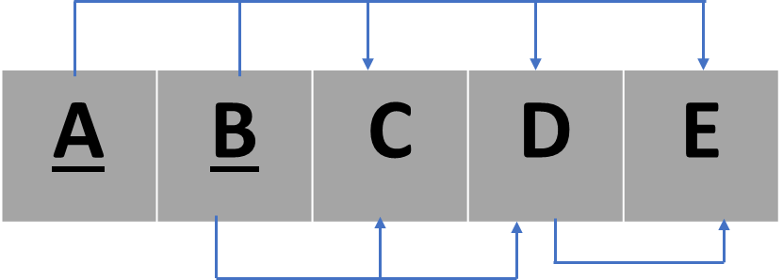
Recall: Functional Dependency Diagram
Relation, R (A,B,C,D,E)
FDs = {
AB --> CDE
B --> CD
D --> E
}
Primary Key (PK)
AB
Full FD (desired)
CDE are fully dependent on AB
Partial dependency (PD)
CD are dependent on B (part of the PK)
Transitive dependency (TD)
E is dependent on D, yet D is a non-prime key and dependent on B
Note:
PD and TD are undesired and need to be removed in database normalization
Desired Dependency
Transitive Dependency
Partial Dependency
Undesired Dependency

Slide 8
First Normal Form
(1NF)

Slide 9
Unnormalized Form (UNF)
Before 1NF, data is In UNF
the table has one or more repeating groups
some cells in the table are nulls
some cells have multiple values.
SEMINAR_CODE | SEMINAR_NAME | DOCTOR_ID | DOCTOR_NAME | SPECIALIZATION_CODE | SPECIALIZATION_NAME | DATE | HOURS_ALLOCATION
s001 | Homeopathic Medicine | D_0108 | Samuel Jones | CAR01 | Cardiology | 01/01/2010 | 8
 |  | D_0124 | Julia Cortez | NEUR1 | Neurology | 01/01/2010 | 16
 |  | D_0140 | Mark Harris | ONCO2 | Oncology | 01/01/2010 | 8
s002 | Cellfood Benefits | D_0110 | Anna Harris | STIN01 | Ent | 01/07/2010 | 8
 |  | D_0140 | Mark Harris | ONCO2 | Oncology | 01/01/2011 | 8
 |  | D_0124 | Julia Cortez | NEUR1 | Neurology | 01/07/2010 | 16,8

Slide 10
Conversion to 1NF
First Normal Form Requirements:
A relation will be 1NF if it contains an atomic value.
cannot be further divided in smaller items (e.g., surname)
An attribute of a table cannot hold multiple values.
It must hold only single-valued attribute.
1NF prohibits multi-valued attributes, and composite attributes.
Hint: multivalued attributes from new table (see lecture 3)
Hint: composite attributes become single attribute in the same table (see lecture 3)

Slide 11
Conversion to 1NF
Step 1: Eliminate the Repeating Groups
Eliminate nulls: each repeating group attribute contains an appropriate data value.
Look for attributes in the relation that contain multiple values within a single tuple.
Step 2: Identify the Primary Key
The primary key that uniquely determines all attributes in each relation/table.
Step 3: Identify All Dependencies
Draw the dependency diagram to depict all dependencies.

Slide 12
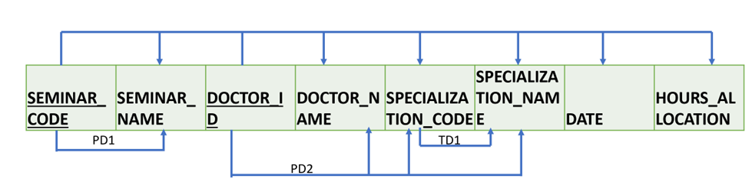
Conversion to 1NF
In 1NF
No repeating groups – each cell has single value
All functional dependencies (full, partial and transitive)
Partial Dependencies
PD1: SEMINAR_CODE – > SEMINAR_NAME
PD2: DOCTOR_ID – > DOCTOR_NAME, SPECIALIZATION_CODE, SPECIALIZATION_NAME)
Transitive Dependencies
TD1: SPECIALIZATION_CODE – > SPECIALIZATION_NAME
Primary key (PK: SEMINAR_CODE + DOCTOR_ID)
All attributes are dependent on a PK
SEMINAR_CODE | SEMINAR_NAME | DOCTOR_ID | DOCTOR_NAME | SPECIALIZATION_CODE | SPECIALIZATION_NAME | DATE | HOURS_ALLOCATION
s001 | Homeopathic Medicine | D_0108 | Samuel Jones | CAR01 | Cardiology | 01/01/2010 | 8
s001 | Homeopathic Medicine | D_0124 | Julia Cortez | NEUR1 | Neurology | 01/01/2010 | 16
s001 | Homeopathic Medicine | D_0140 | Mark Harris | ONCO2 | Oncology | 01/08/2010 | 8
s002 | Cellfood Benefits | D_0110 | Anna Harris | STIN01 | Ent | 01/07/2010 | 8
s002 | Cellfood Benefits | D_0140 | Mark Harris | ONCO2 | Oncology | 01/01/2011 | 8
s002 | Cellfood Benefits | D_0124 | Julia Cortez | NEUR1 | Neurology | 01/07/2010 | 16
s002 | Cellfood Benefits | D_0124 | Julia Cortez | NEUR1 | Neurology | 01/07/2010 | 8

Slide 13
Second Normal Form
(2NF)

Slide 14
Conversion to 2NF
Second Normal Form Requirements:
The relation must first be in 1NF.
The relation is automatically in 2NF,
if the 1NF key is a single attribute.
however, If the relation has a composite PK,
then each non-key attribute must be fully dependent on the entire PK and not on a part of the PK (no partial dependency).

Slide 15
Conversion to 2NF
Steps:
Step 1: Create new tables/relations to remove all partial dependencies (PD)
Each PD forms a new table with its copy of PK remaining in original table as FK
Step 2: Reassign corresponding dependent attributes to a PK in each table
Attributes in a PD are removed from original table are assigned to their corresponding PK of the new table in step 1.

Slide 16
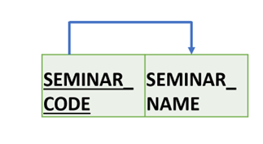
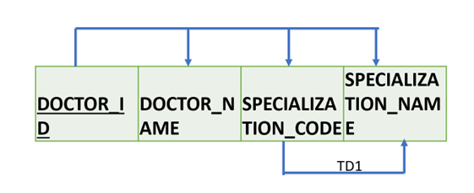
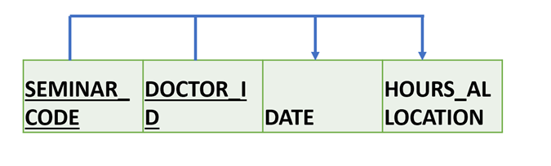
Conversion to 2NF
PD1 forms SEMINAR table
PD2 forms DOCTOR table
Original table becomes SEMINAR_DOCTOR table
SEMINAR_CODE – > SEMINAR_NAME
DOCTOR_ID – > DOCTOR_NAME, SPECIALIZATION_CODE, SPECIALIZATION_NAME
SEMINAR_CODE, DOCTOR_ID – > DATE, ALLOCATION_HOURS

Slide 17
Conversion to 2NF
SEMINAR_CODE | SEMINAR_NAME
s001 | Homeopathic Medicine
s002 | Cellfood Benefits
In 2NF
Each table is in 1NF.
None of the tables include partial dependencies.
Each attributes is fully dependent on a PK in each table.
DOCTOR_ID | DOCTOR_NAME | SPECIALIZATION_CODE | SPECIALIZATION_NAME
D_0108 | Samuel Jones | CAR01 | Cardiology
D_0124 | Julia Cortez | NEUR1 | Neurology
D_0140 | Mark Harris | ONCO2 | Oncology
D_0110 | Anna Harris | STIN01 | Ent
SEMINAR_CODE – > SEMINAR_NAME
SEMINAR (SEMINAR_CODE, SEMINAR_NAME)
DOCTOR_ID – > DOCTOR_NAME, SPECIALIZATION_CODE, SPECIALIZATION_NAME
SEMINAR_CODE | DOCTOR_ID | DATE | HOURS_ALLOCATION
s001 | D_0108 | 01/01/2010 | 8
s001 | D_0124 | 01/01/2010 | 16
s001 | D_0140 | 01/01/2010 | 8
s002 | D_0110 | 01/07/2010 | 8
s002 | D_0140 | 01/01/2011 | 8
s002 | D_0124 | 01/07/2010 | 16
s002 | D_0124 | 01/07/2010 | 8
DOCTOR (DOCTOR_ID, DOCTOR_NAME, SPECILIZATION_CODE, SPECIALIZATION_NAME)
SEMINAR_CODE, DOCTOR_ID – > DATE, ALLOCATION_HOURS
SEMINAR_DOCTOR (SEMINAR_CODE, DOCTOR_ID, DATE, HOURS_ALLOCATION)

Slide 18
Third Normal Form
(3NF)

Slide 19
Conversion to 3NF
Third Normal Form Requirements:
A relation will be in 3NF
if it is in 2NF and
Not contain any transitive dependency.
If there is no transitive dependency for non-prime attributes,
then the relation must be in 3NF.

Slide 20
Conversion to 3NF
Steps:
Step 1: Create new tables/relations to remove all transitive dependencies (TD)
For every TD, write its determinant as PK for a new table.
Retain a copy of the determinant in the original table (where TD exists) to serve as a FK.
Step 2: Reassign corresponding dependent attributes to a PK in the new table
Identify attributes dependent on each determinant identified in Step 1. Name the new table to reflect its contents and function.

Slide 21
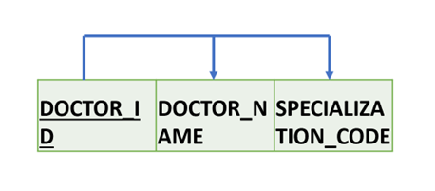
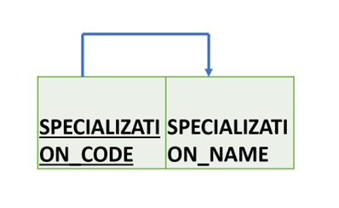
Conversion to 3NF
Remove Transitive dependencies
Select the tables with TD
decompose those table in new relations
the rest of the tables without TD remain unchanged.
DOCTOR_ID | DOCTOR_NAME | SPECIALIZATION_CODE
D_0108 | Samuel Jones | CAR01
D_0124 | Julia Cortez | NEUR1
D_0140 | Mark Harris | ONCO2
D_0110 | Anna Harris | STIN01
DOCTOR (DOCTOR_ID, DOCTOR_NAME, SPECILIZATION_CODE, SPECIALIZATION_NAME)
DOCTOR (DOCTOR_ID, DOCTOR_NAME, SPECILIZATION_CODE)
SPECIALIZATION_CODE | SPECIALIZATION_NAME
CAR01 | Cardiology
NEUR1 | Neurology
ONCO2 | Oncology
STIN01 | Ent
TD1: SPECILIZATION_CODE – > SPECIALIZATION_NAME)
SPECIALIZATION (SPECIALIZATION_CODE, SPECILIZATION_NAME)

Slide 22
Conversion to 3NF
Normalized tables in 3NF
SEMINAR_CODE | SEMINAR_NAME
s001 | Homeopathic Medicine
s002 | Cellfood Benefits
Relation Schemas in 3NF
SEMINAR (SEMINAR_CODE, SEMINAR_NAME)
SPECIALIZATION (SPECIALIZATION_CODE, SPECILIZATION_NAME)
DOCTOR (DOCTOR_ID, DOCTOR_NAME, SPECILIZATION_CODE)
SEMINAR_DOCTOR (SEMINAR_CODE, DOCTOR_ID, DATE, HOURS_ALLOCATION)
SPECIALIZATION_CODE | SPECIALIZATION_NAME
CAR01 | Cardiology
NEUR1 | Neurology
ONCO2 | Oncology
STIN01 | Ent
DOCTOR_ID | DOCTOR_NAME | SPECIALIZATION_CODE
D_0108 | Samuel Jones | CAR01
D_0124 | Julia Cortez | NEUR1
D_0140 | Mark Harris | ONCO2
D_0110 | Anna Harris | STIN01
Functional dependency diagrams in 3NF
SEMINAR_CODE | DOCTOR_ID | DATE | HOURS_ALLOCATION
s001 | D_0108 | 01/01/2010 | 8
s001 | D_0124 | 01/01/2010 | 16
s001 | D_0140 | 01/01/2010 | 8
s002 | D_0110 | 01/07/2010 | 8
s002 | D_0140 | 01/01/2011 | 8
s002 | D_0124 | 01/07/2010 | 16
s002 | D_0124 | 01/07/2010 | 8

Slide 23
Conversion to 3NF
Normalized data
SEMINAR_CODE | SEMINAR_NAME
s001 | Homeopathic Medicine
s002 | Cellfood Benefits
In 3NF
Each table is in 2NF
None of the tables includes transitive dependencies
SPECIALIZATION_CODE | SPECIALIZATION_NAME
CAR01 | Cardiology
NEUR1 | Neurology
ONCO2 | Oncology
STIN01 | Ent
DOCTOR_ID | DOCTOR_NAME | SPECIALIZATION_CODE
D_0108 | Samuel Jones | CAR01
D_0124 | Julia Cortez | NEUR1
D_0140 | Mark Harris | ONCO2
D_0110 | Anna Harris | STIN01
Unnormalized data
SEMINAR_CODE | SEMINAR_NAME | DOCTOR_ID | DOCTOR_NAME | SPECIALIZATION_CODE | SPECIALIZATION_NAME | DATE | HOURS_ALLOCATION
s001 | Homeopathic Medicine | D_0108 | Samuel Jones | CAR01 | Cardiology | 01/01/2010 | 8
 |  | D_0124 | Julia Cortez | NEUR1 | Neurology | 01/01/2010 | 16
 |  | D_0140 | Mark Harris | ONCO2 | Oncology | 01/01/2010 | 8
s002 | Cellfood Benefits | D_0110 | Anna Harris | STIN01 | Ent | 01/07/2010 | 8
 |  | D_0140 | Mark Harris | ONCO2 | Oncology | 01/01/2011 | 8
 |  | D_0124 | Julia Cortez | NEUR1 | Neurology | 01/07/2010 | 16
 |  | D_0124 | Julia Cortez | NEUR1 | Neurology | 01/07/2010 | 8
SEMINAR_CODE | DOCTOR_ID | DATE | HOURS_ALLOCATION
s001 | D_0108 | 01/01/2010 | 8
s001 | D_0124 | 01/01/2010 | 16
s001 | D_0140 | 01/01/2010 | 8
s002 | D_0110 | 01/07/2010 | 8
s002 | D_0140 | 01/01/2011 | 8
s002 | D_0124 | 01/07/2010 | 16
s002 | D_0124 | 01/07/2010 | 8

Slide 24
Activities
Find enrichment activities on conversion to 1NF/2NF/3NF under the assessment section
Attempt activities 7.1 and 7.2

Slide 25
Summary
Define:
Database Normalization
Need for Database Normalization
Normalization Process
Normal Forms
Conversion to 1NF
Conversion to 2NF
Conversion to 3NF
🡺NEXT
Boyce Codd NF and 4NF

